Slide 1

SYSTEM DESIGN
Alessia Saporita, Vincenzo Lapadula,
Michele Giarletta

Slide 2
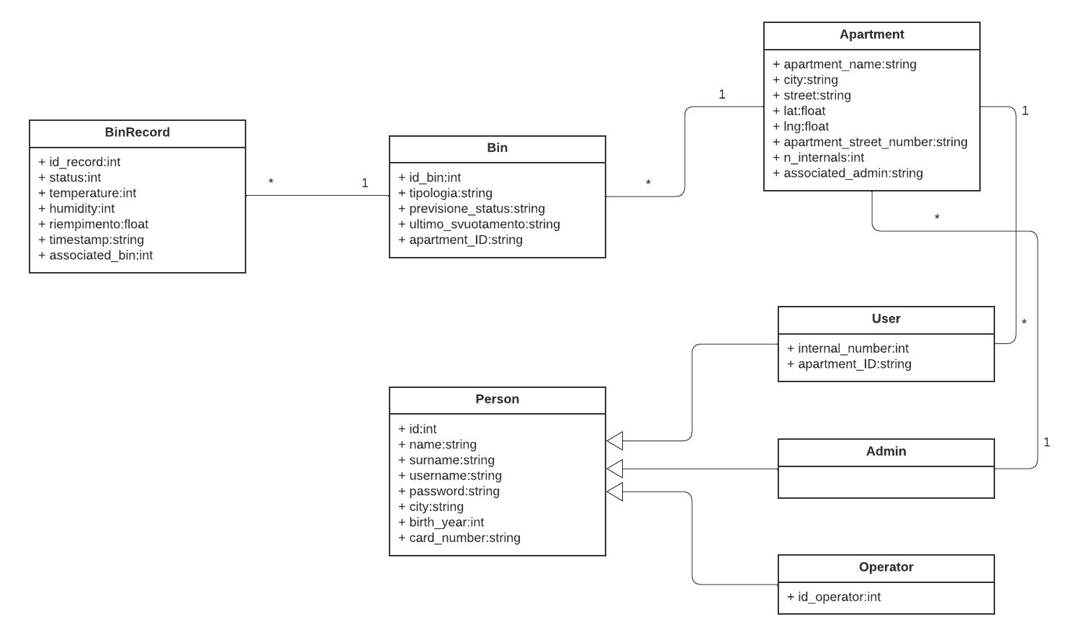
UML Class

Slide 3
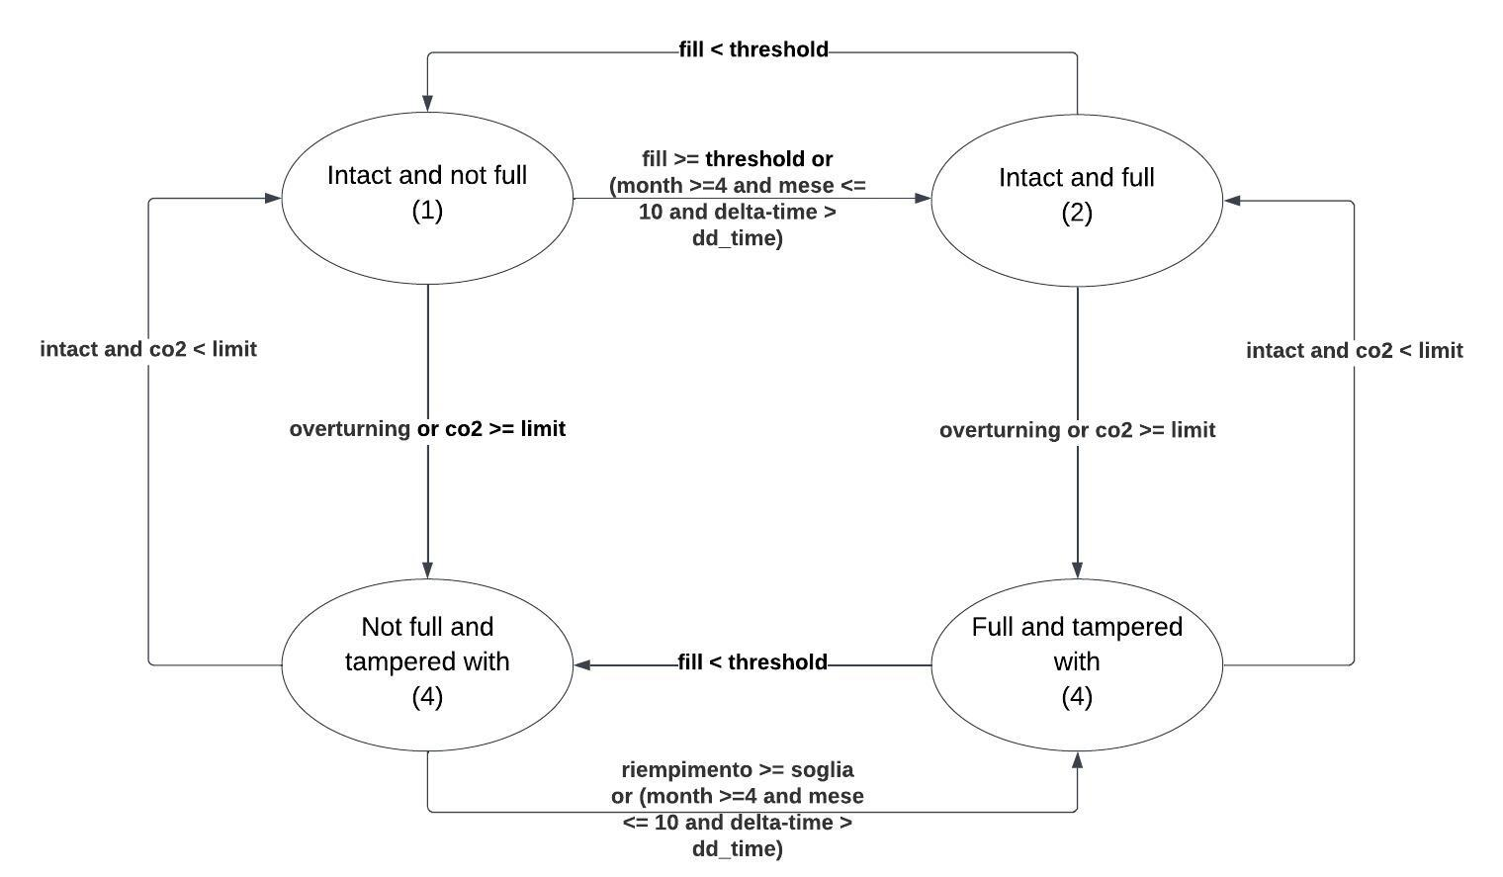
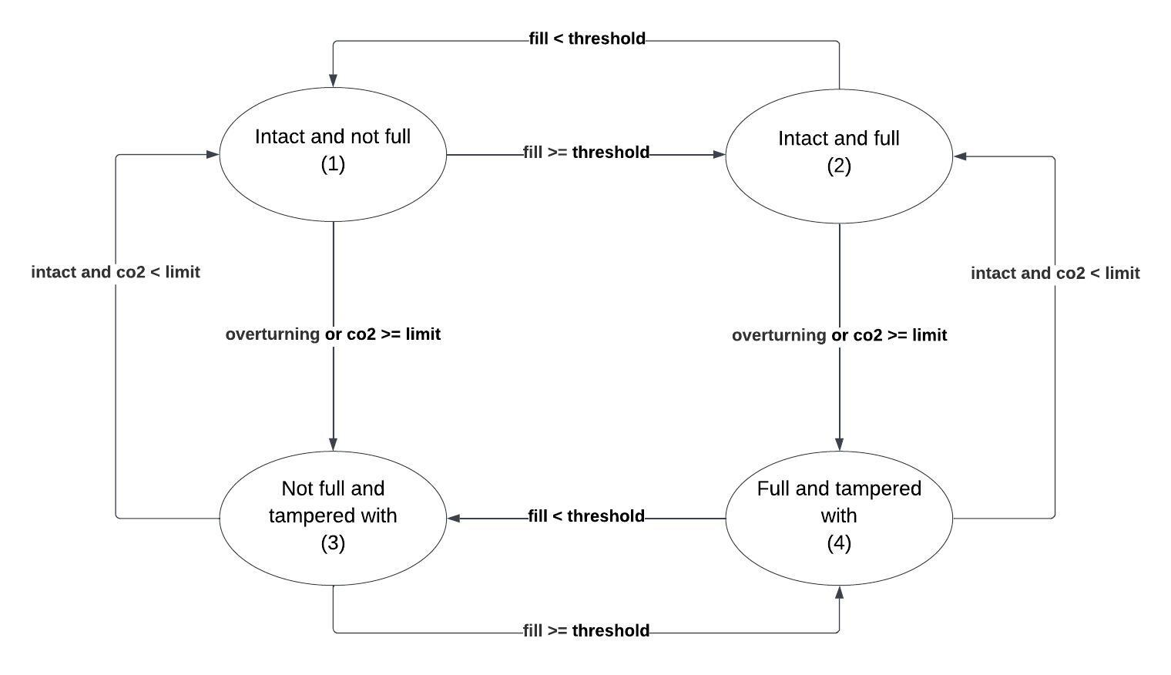

Finite state machine

Slide 4

Finite state machine for organic waste
delta_time = interval of days since the last emptying
dd_time = number of days that can elapse since the last emptying. Depending on the temperature it is 5 days for average temperatures, 3 for high temperatures and 2 for very high temperatures.

Slide 5
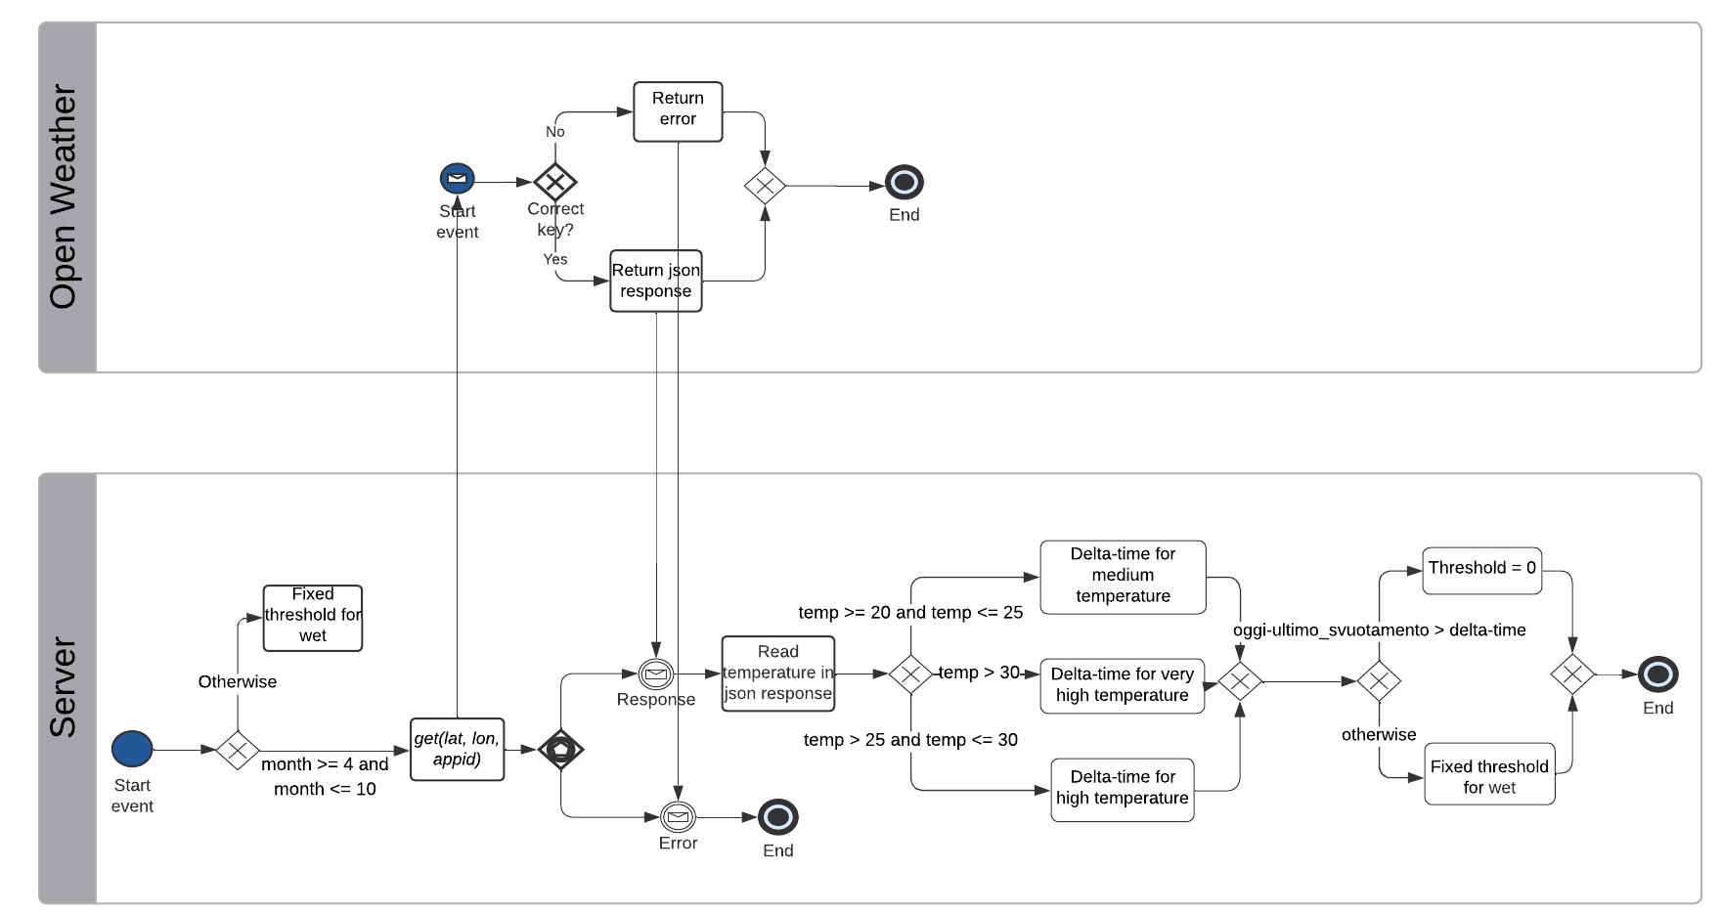
Get organic waste threshold

Slide 6
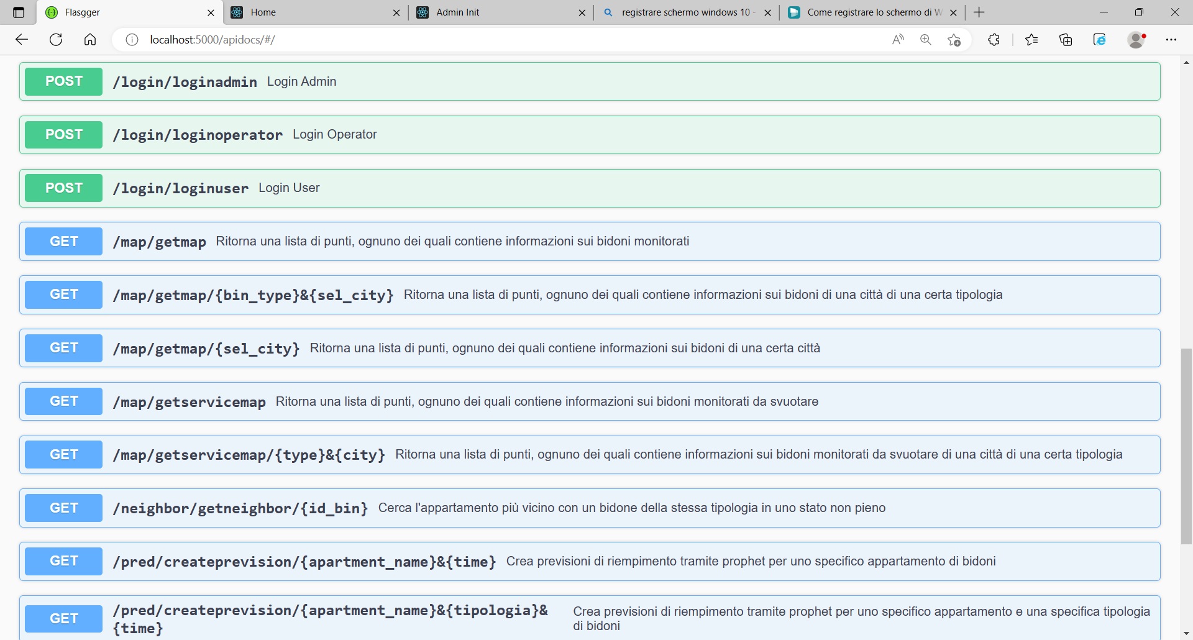
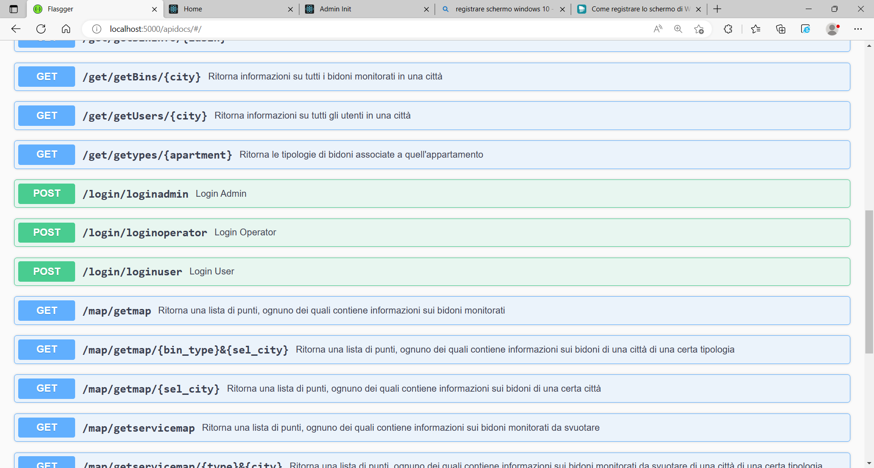
API map

Slide 7
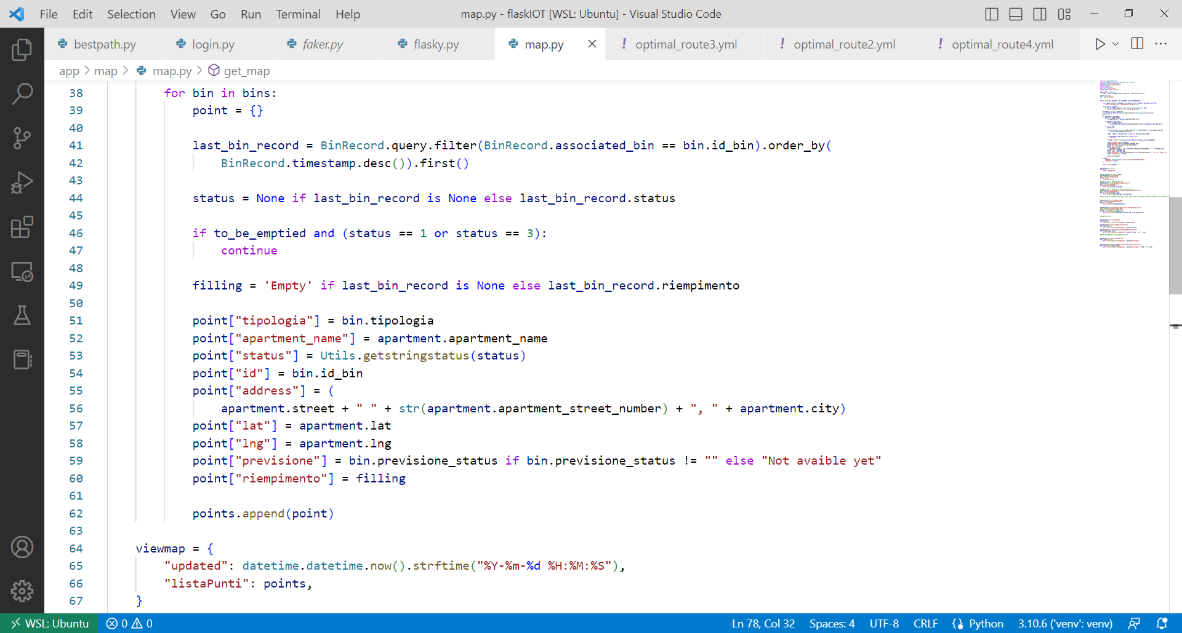
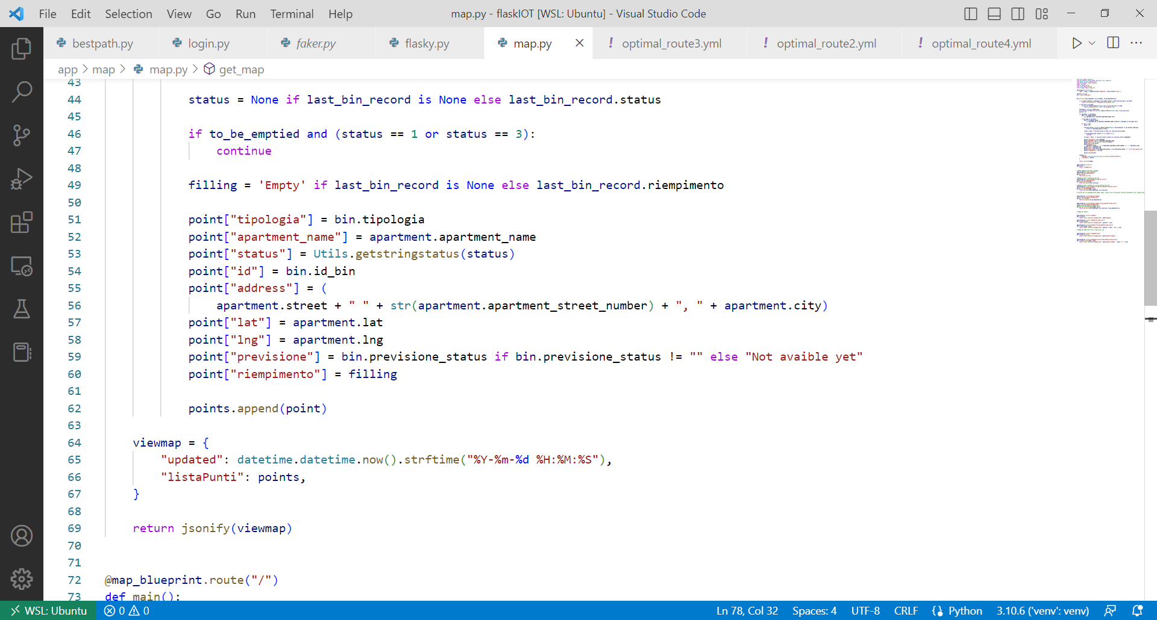
Map
We create a list of points
Each point corresponds to a bin
Each point is described by a dictionary that contains the information about the bin (typology, status, address, etc…)

Slide 8
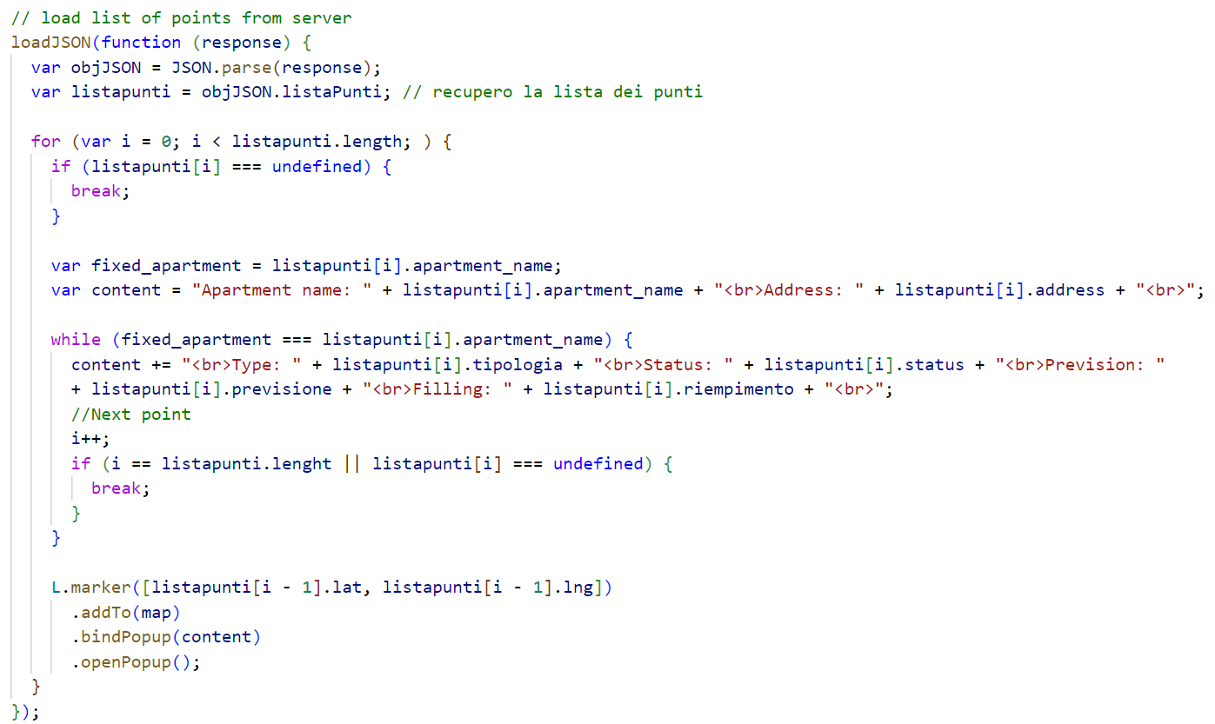
Map

Slide 9
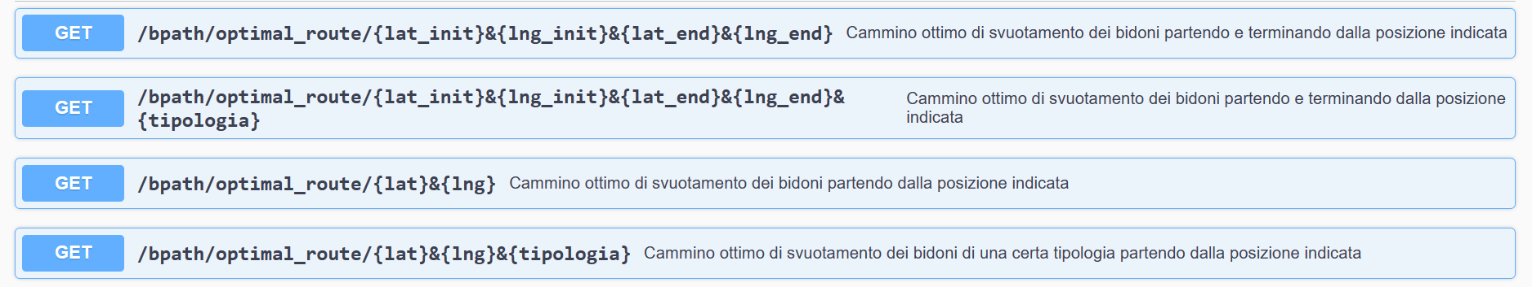
API Best Path

Slide 10
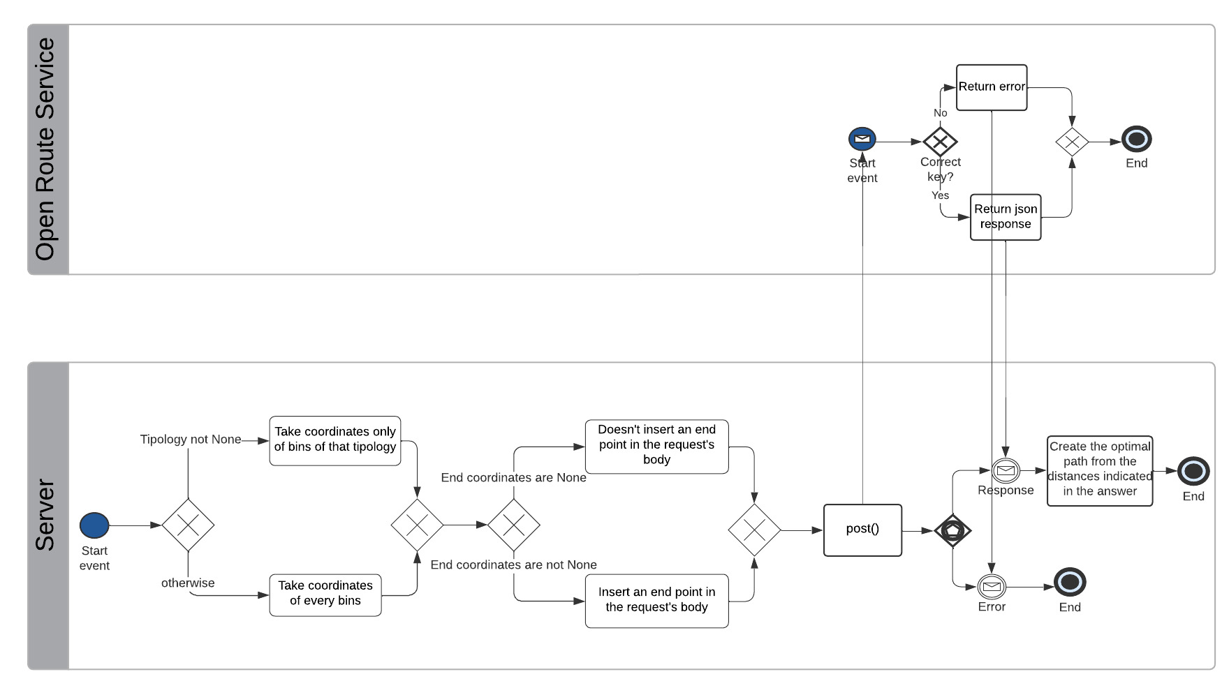
Optimal route

Slide 11
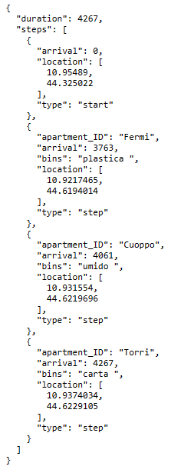
JSON Response

Slide 12
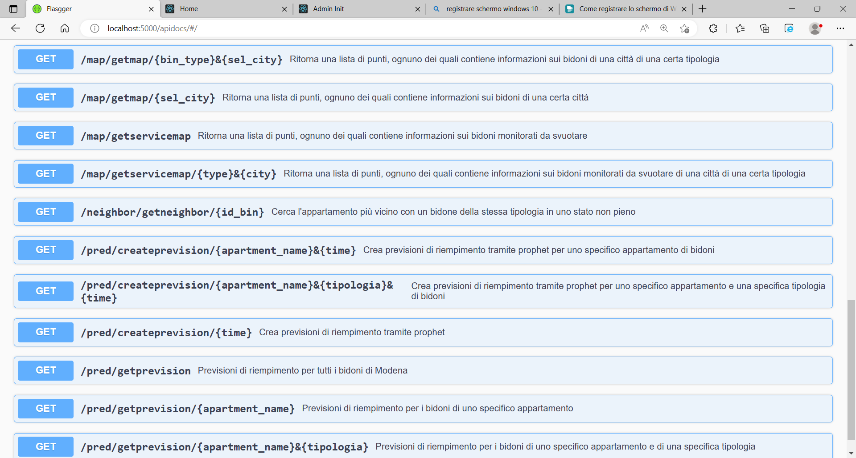
API Neighbor

Slide 13
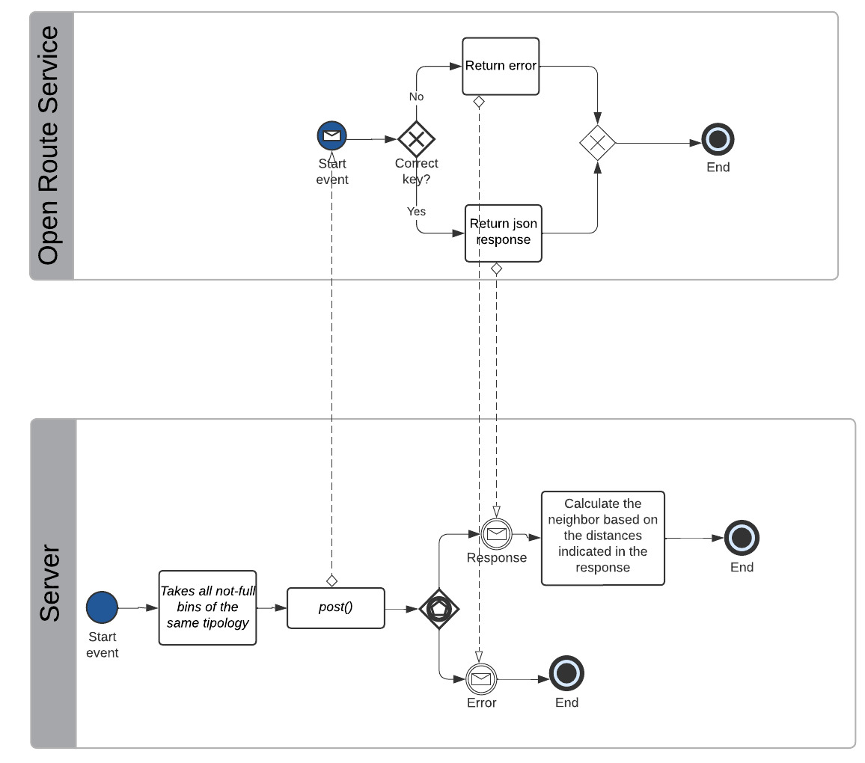
Get neighbor

Slide 14
API login

Slide 15
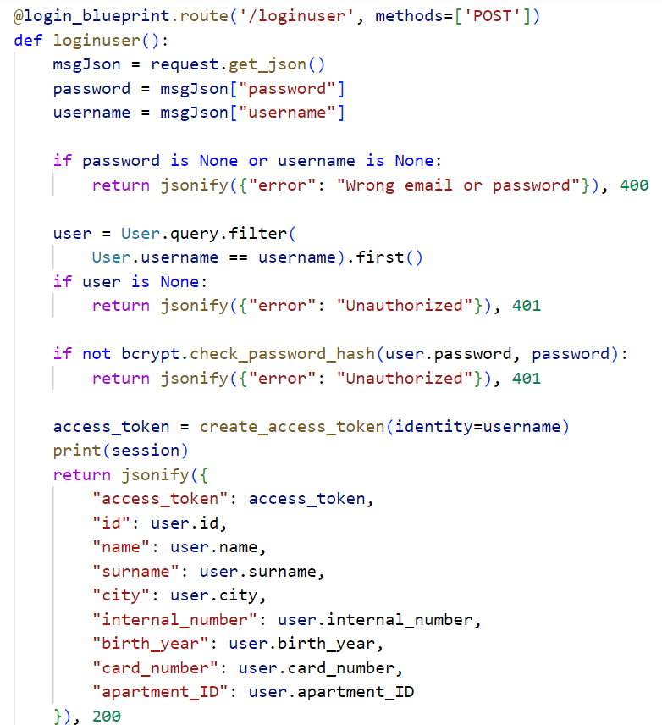
Login
JWT is an Open standard for creating access tokens between a server and a client.
“flask-jwt-extended” is a flask extension that provides us with the @jwt_required decorator, which allows access to the endpoint only after verification of the Token.

Slide 16
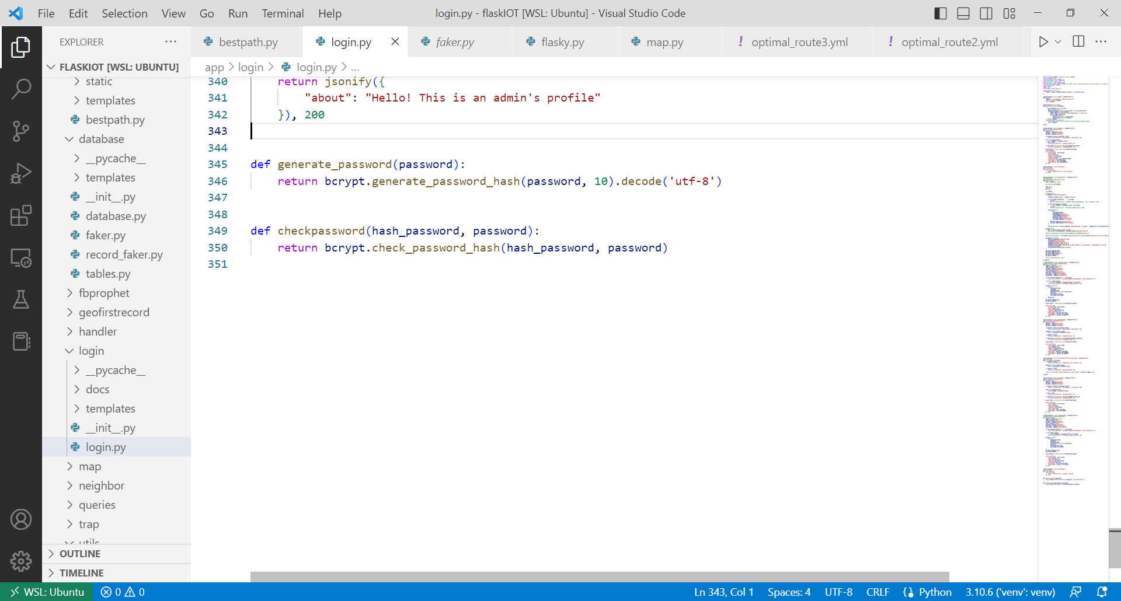
Authentication
Flask-Bcrypt is a Flask extension that provides bcrypt hashing utilities for your application
Bcrypt is a hashing algorithm. It takes in a plain text password as an input and returns a hash of that password.
check_password_hash() tests a password hash against a candidate password
generate_password_hash() generates a password hash using bcrypt

Slide 17
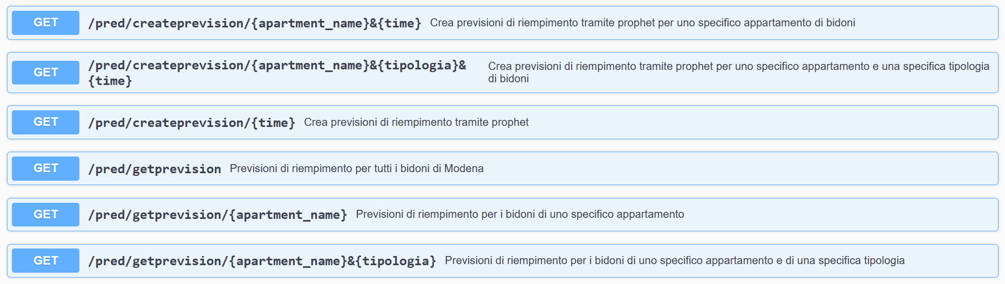
API Prophet

Slide 18
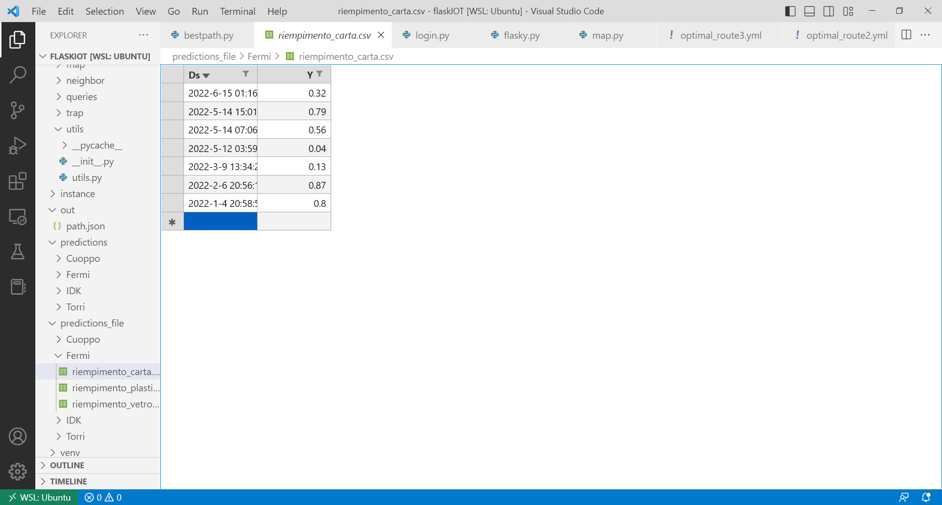
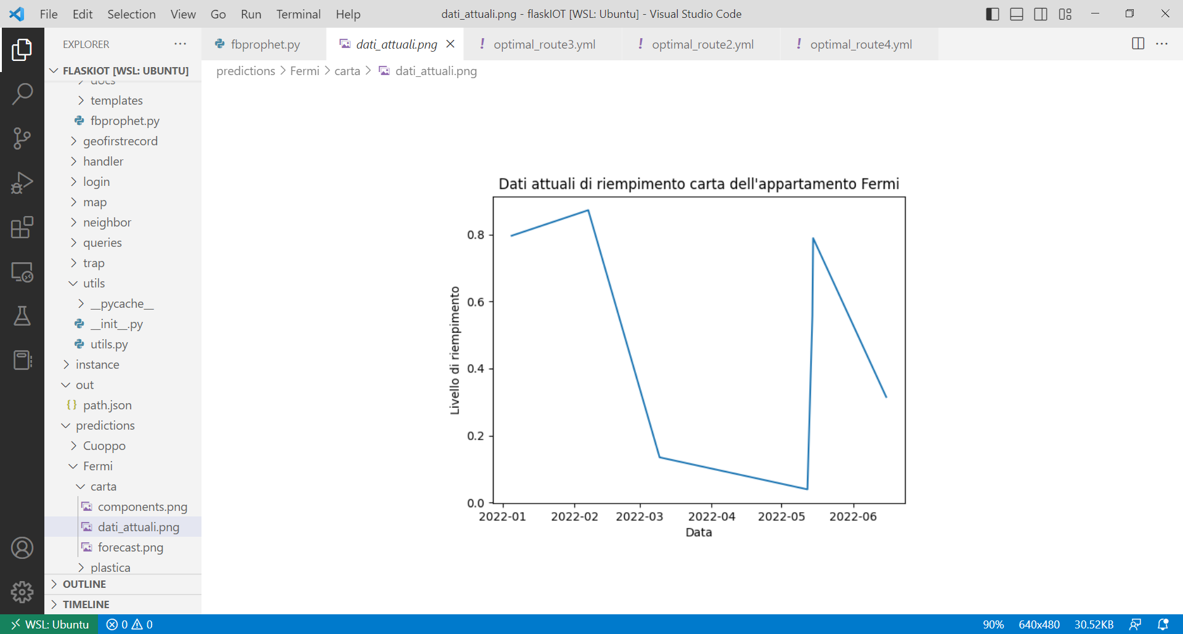
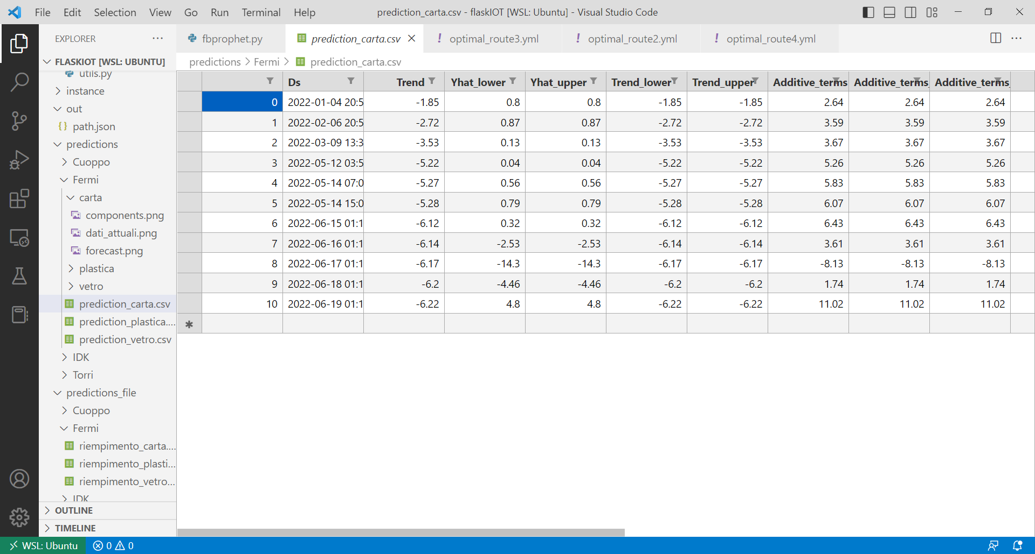
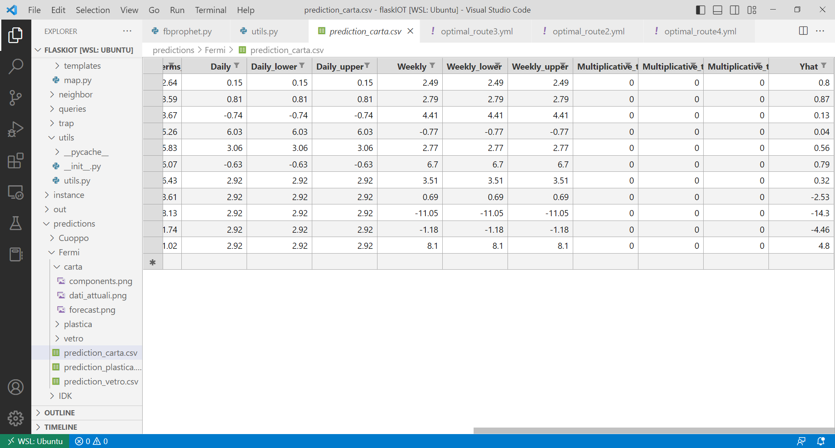
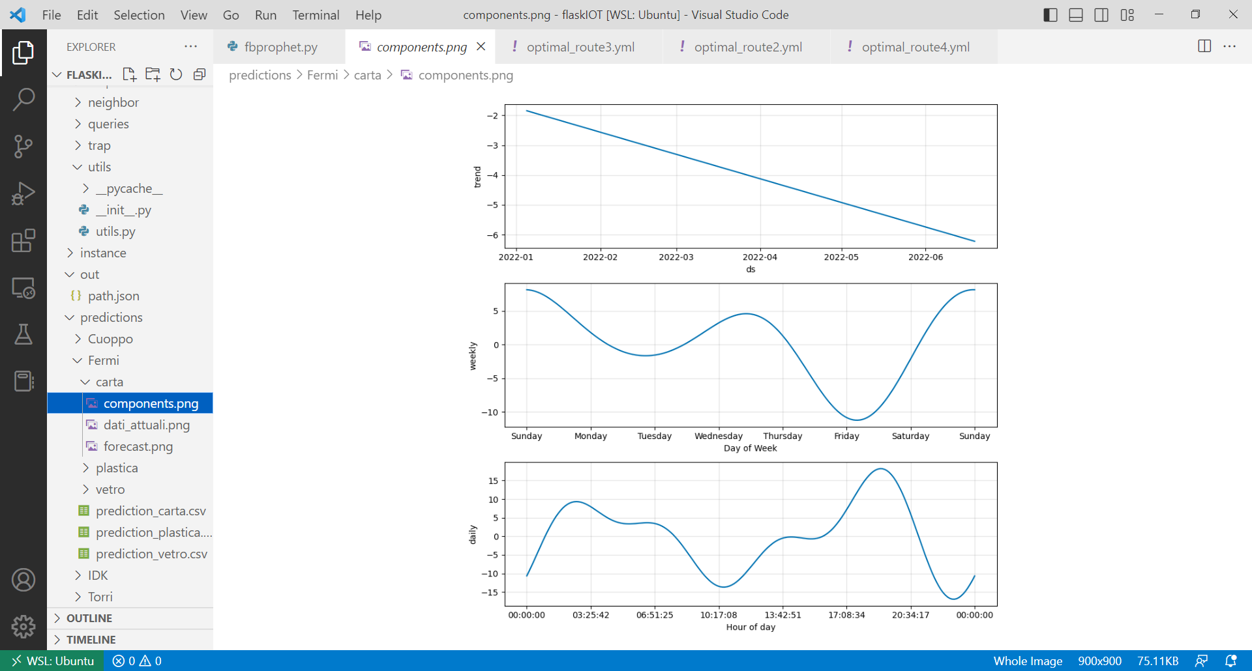
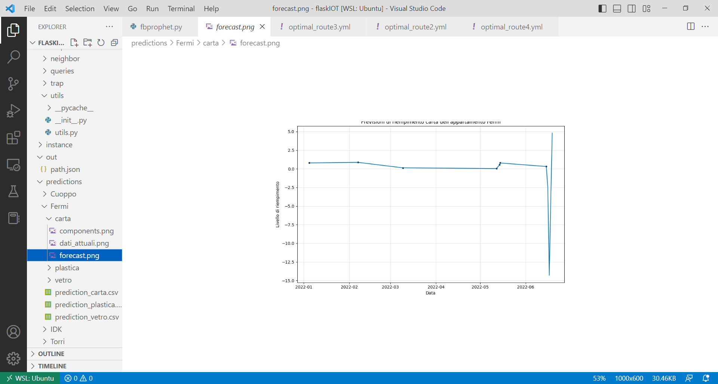
Facebook Prophet
Filling of the paper waste of the Fermi apartment
Current fill level graph of the paper waste of the Fermi apartment
Filling predictions made by facebook prophet
Forecast plot: A graph containing a plot of historical data points indicated by black dots and the forecast curve indicated by a blue line.
Components plot: a group of plots corresponding to various time series components (trend, seasonilities)

Slide 19












Software Technologies

Slide 20
Thanks for your attention! Questions?

Slide 21

Electronic devices
Alessia Saporita, Vincenzo Lapadula,
Michele Giarletta

Slide 22
Electronic devices
Sensors
Actuators
3-axis gyroscope MPU-6050
CO2 sensor Mq135
Temperature and humidity sensor DHT11
Ultrasonic sensor HC SR04
16x2 I2C LCD display
RFID RC-522
Microcontroller
ESP32

Slide 23
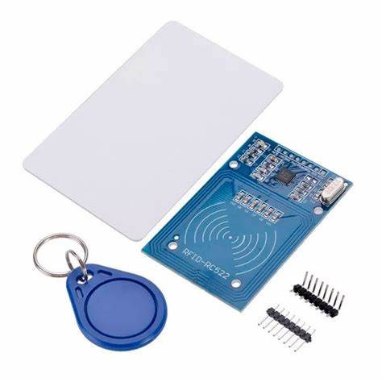
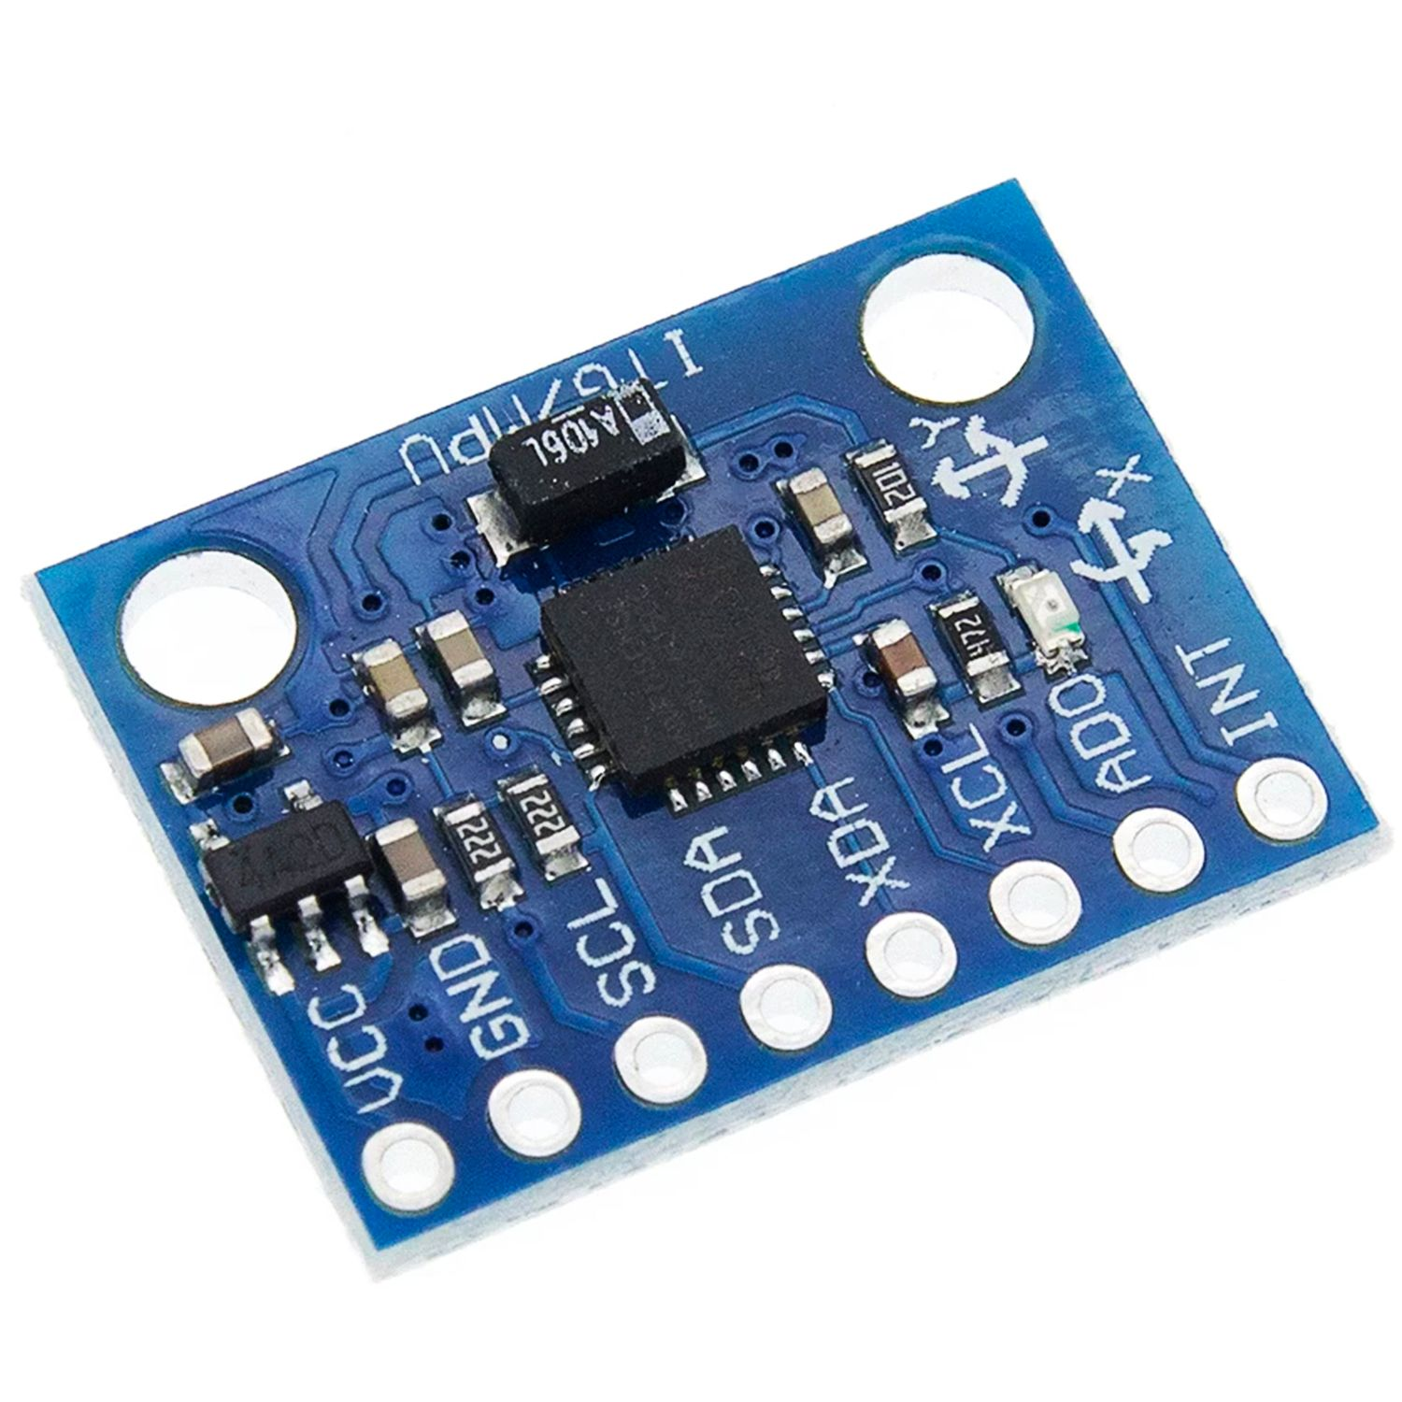
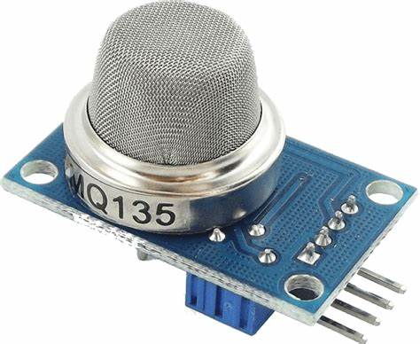
Sensors
3-axis gyroscope MPU-6050:
Used to detect the movement direction and magnitude
I2C Interface
Low-cost
Easy to get up and running and capturing the raw data output of the device
CO2 sensor Mq135:
Used to detect the presence of flammable gases
Marketed as a generalized “air quality” sensor, capable of measuring the concentrations of several gases, one of which is CO2
Low-cost alternative to more specialized (and more expensive) CO2-specific sensors

Slide 24
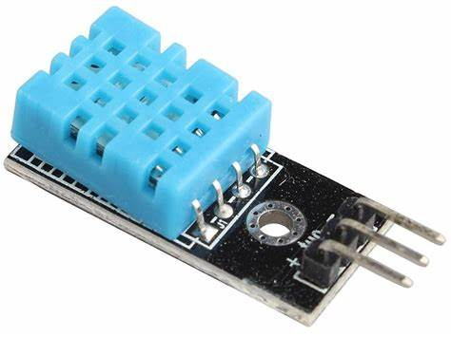
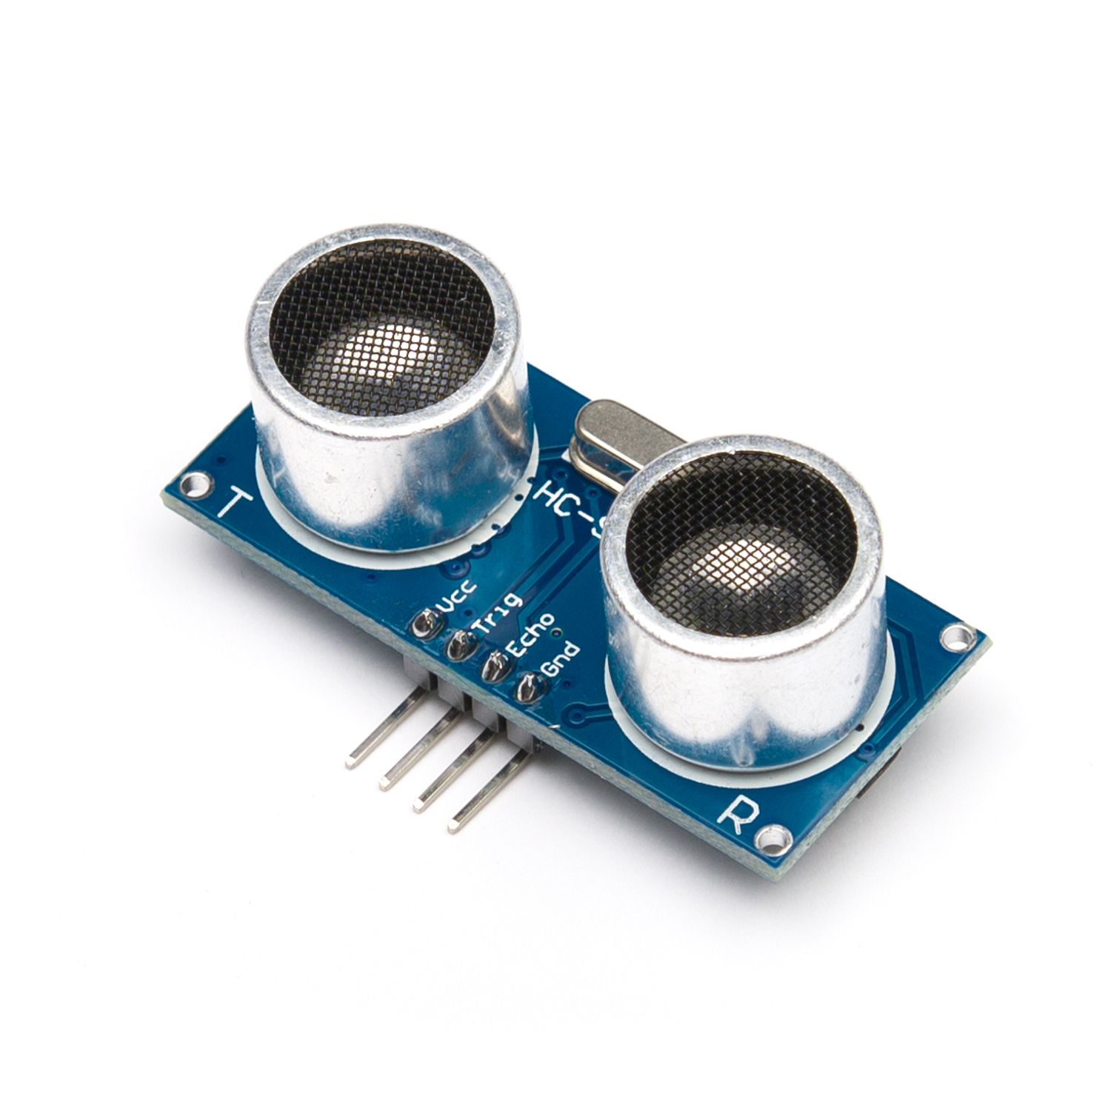
Sensors
Temperature and humidity sensor DHT11:
Output: Serial data
Temperature Range: 0°C to 50°C
Humidity Range: 20% to 90%
Accuracy: ±1°C and ±1%
Easy to interface with other microcontrollers
Ultrasonic sensor HC SR04:
Minimum measurable distance 2cm
Maximum distance measurable 400cm
Resolution: 3 mm
Simple method for measuring distances, where high precision combined with a high measuring range is required

Slide 25
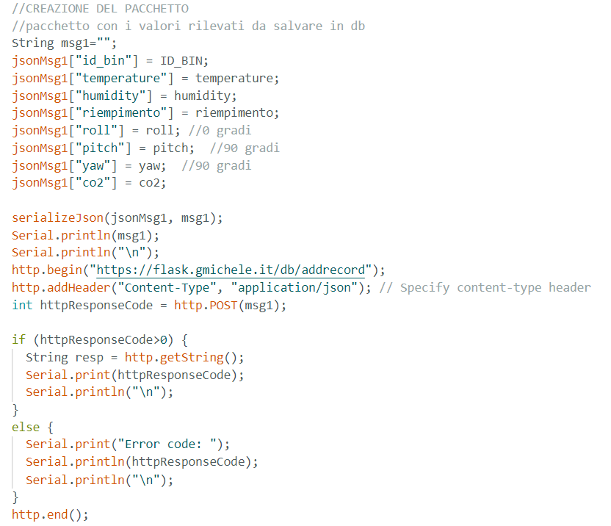
Sensors: package

Slide 26
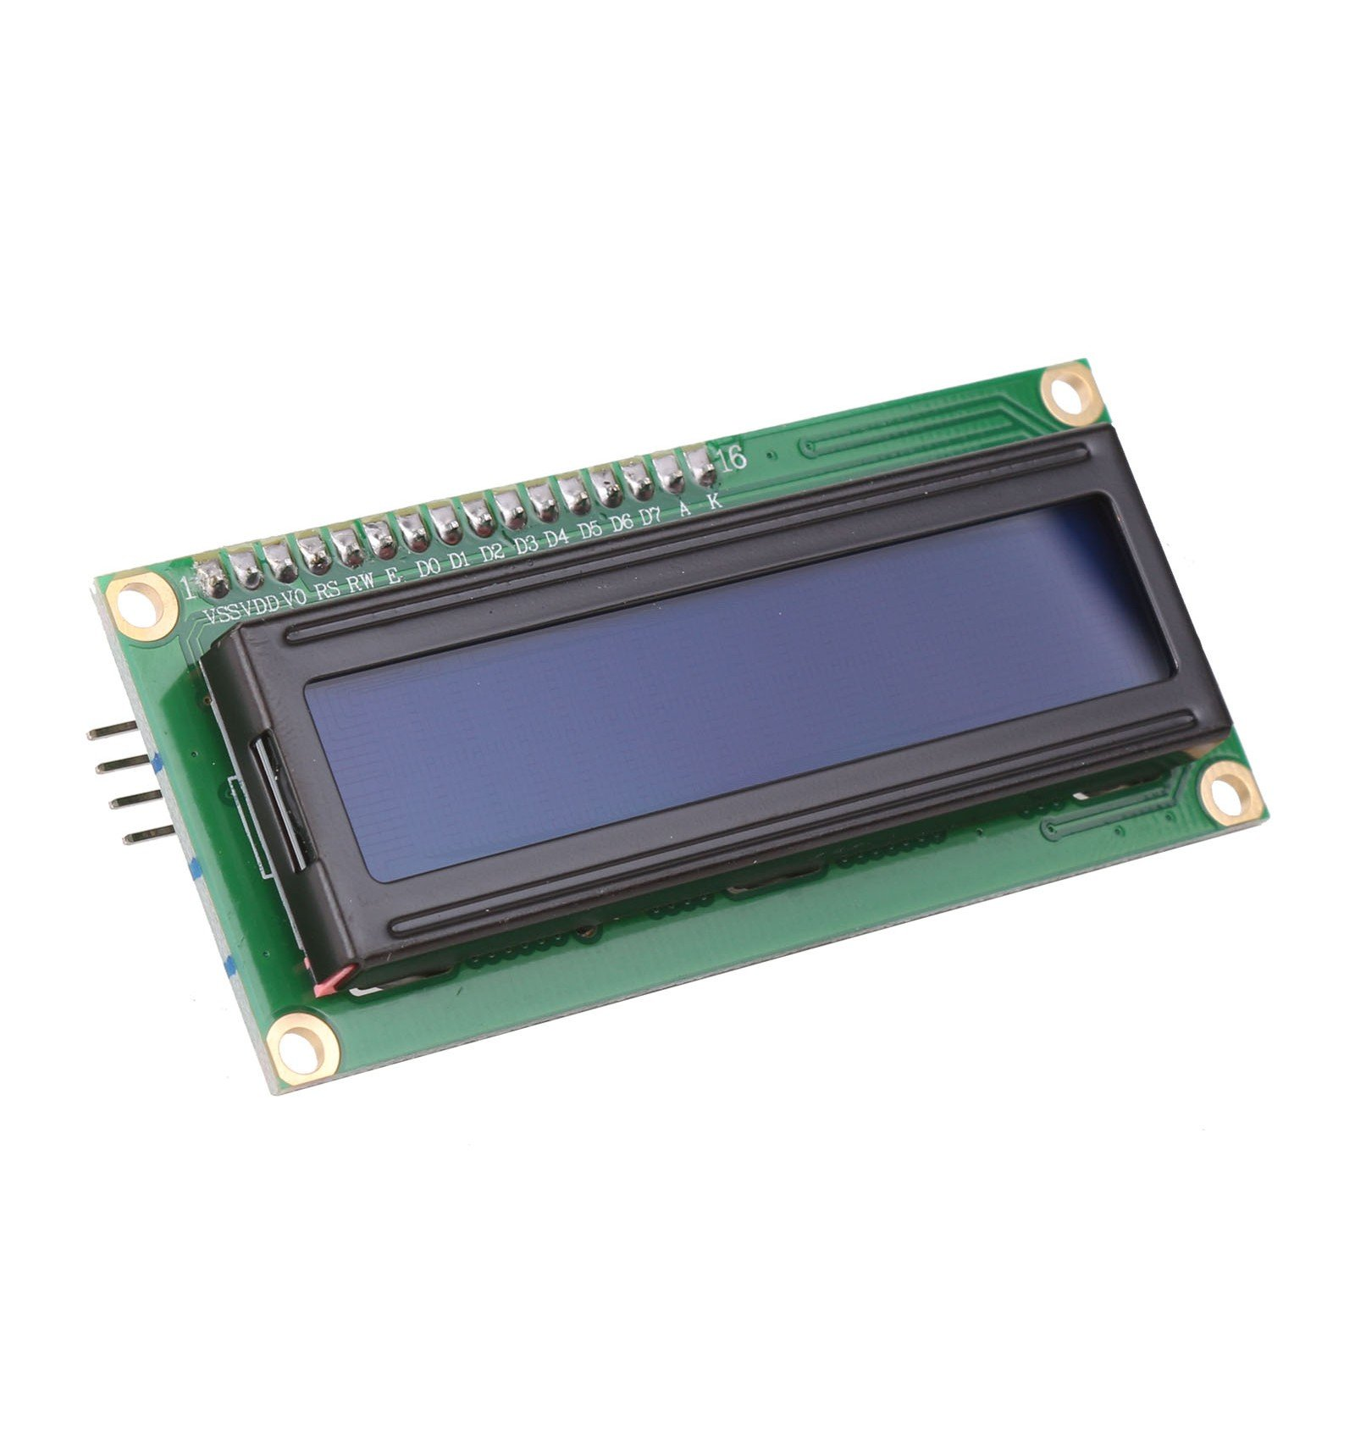
Actuators
Card Reader RFID RC-522 :
It is normally used in application where certain person/object has to be identified with a unique ID.
Communication : SPI, I2C protocol, UART
The module can be easily used with Arduino because of its readily available RC522 RFID Arduino library
RF Module consists of a RFID reader, RFID card and a key chain
16x2 I2C LCD display:
It allows you to display up to 32 characters at a time, arranged in 2 lines of 16 characters each
the integrated I2C communication interface makes it extremely easy to use with Arduino

Slide 27
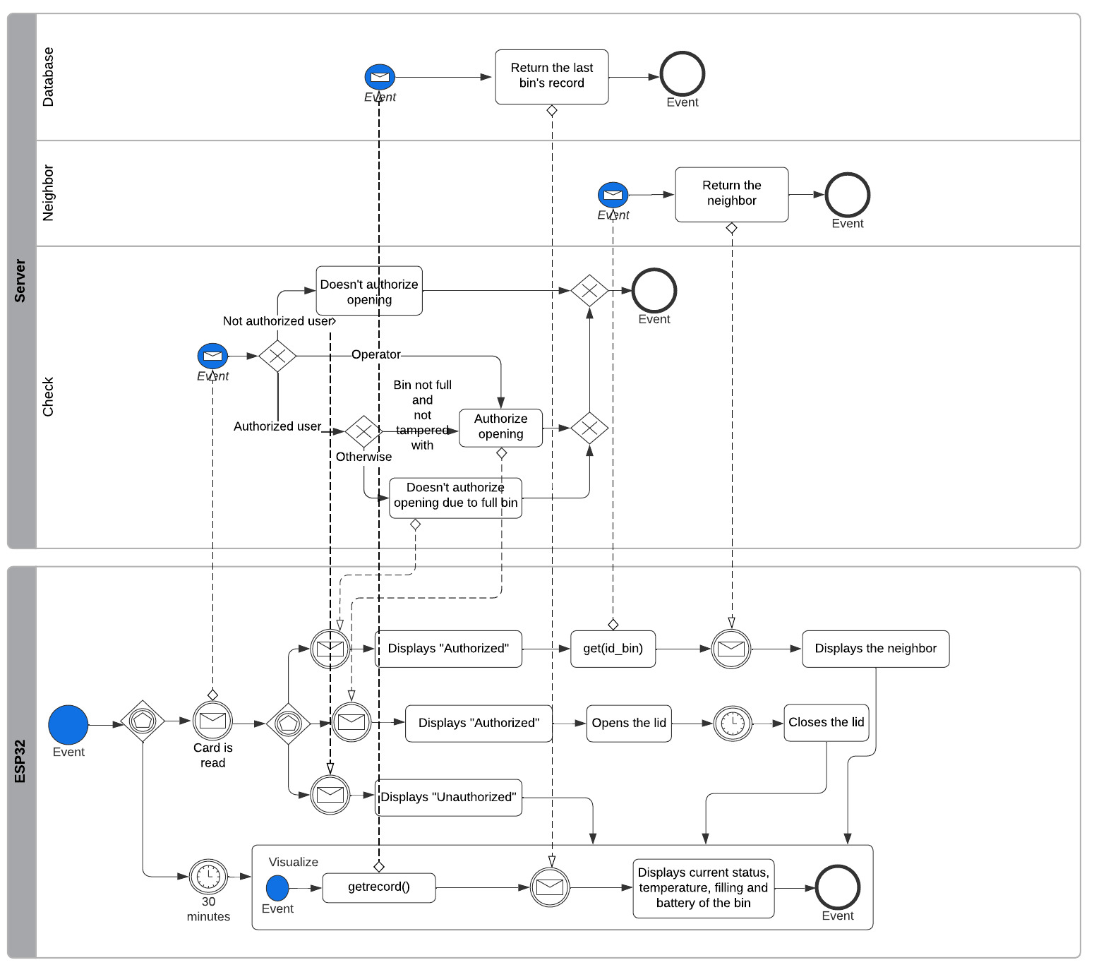
Actuators

Slide 28
Thanks for your attention! Questions?

